Slide 1
Contribution of Islamic Banking in the Prosperity of Tanzanian Society: A Case of Amana Bank
Dr. Muhsin Salim Masoud
Managing Director

Slide 2
Overview
Our Mission and Vision.
Amana Bank presence in the Market.
Contribution of Amana Bank in Tanzania.
Financing
Small Business
Employment
Deposit (Customer Reach)
Charity Contribution
Paid Taxes
Strength of Islamic Banking.
Amana Bank products and Services.

Slide 3
Our Mission and Vision
To provide unique and innovative financial solutions which are Sharia compliant in an ethical and transparent manner driven by cutting-edge technology for the benefit of all stakeholders
We aspire to be the preferred and leading provider of Sharia compliant financial solutions in our markets.

Slide 4
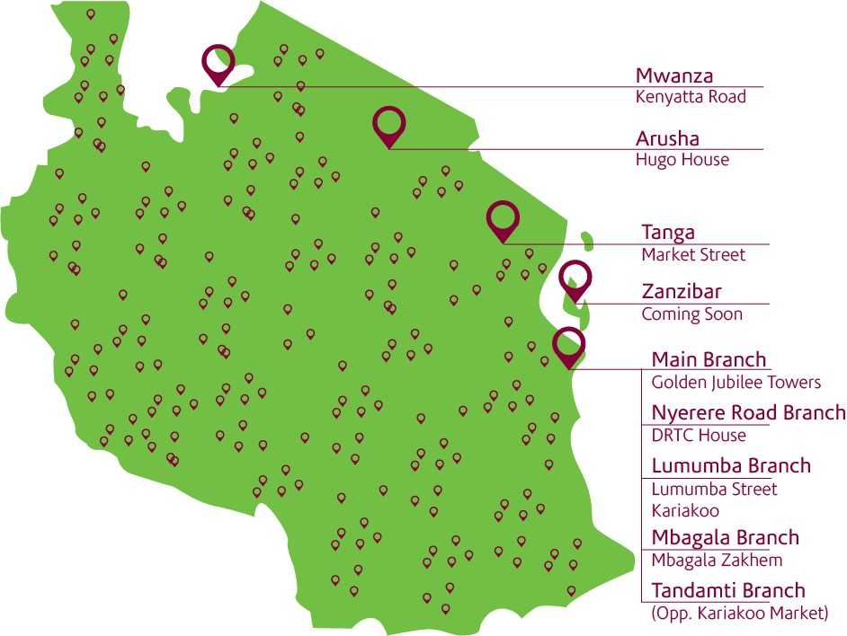
Our Presence in the Market

Slide 5
Contribution of Amana Bank in Tanzania

Slide 6
Contribution of Amana Bank in Tanzania
Our financing book and number customers financed.
Sector Amount in Mil
Mining & Quarrying 264
Manufacturing 4,782
Building and Construction 10,206
Transport and Communication 19,370
Trade 84,391
Hotels & restaurant 3,343
Housing and Storage 41
Education 1,082
Persona and Other Services 9,244

Slide 7
Contribution of Amana Bank in Tanzania
Our small business book and number customers financed.
Small Business has helped to improve financial inclusion.
We expect to launch group financing in 2018
Year | Number of Customer | Amount Financed
2016 | 39 | 184 mil
2017 | 357 | 1.56 Bil

Slide 8
Contribution of Amana Bank in Tanzania
Amana Bank contribution to employment in Tanzania
Category | Number of Staff
Permanent Staff | 182
Contractual (Sales Executives, Graduate trainees and Interns) | 45
Agents | 286
Indirect (through Business we support) | To be established

Slide 9
Contribution of Amana Bank in Tanzania
The bank has reached about 62,000 customer with total deposit of TZS 178 bil
Deposits
Accounts

Slide 10
Contribution of Amana Bank in Tanzania
The bank has paid tax on average of 2.1 billion per year over past six years
Charity contribution to the society
Category | Number of Beneficiaries | Amount Contributed
Education Sector | 444 | 406 mil
Health Sector | 108 | 178 mil
Humanitarian Sector | 32 | 93 mil
 |  | 678 mil
Customer promise to pay nominal charity in case of default/delay.
Charity fund is not part of the income of the bank. It is used to support poor and orphans in accessing education and medication services.
Penalty can be waived if the customer is in real difficulty.

Slide 11
Strength and beauty of Islamic Banking

Slide 12
Strength and beauty of Islamic Banking. Cont.,
Asset and service backed banking
Funds are channeled directly to real economic activities.
Prevents diversion of funds through making payment direct to suppliers and delivering asset to customers.
Ensure funds are used for intended productive purpose, this improves customers repayment ability and minimize default risk.
Asset may be used to recover the balance of debt and leave collateral untouched.

Slide 13
Strength and beauty of Islamic Banking. cont.,
An ethical banking which helps the economy to grow ethically.
Prohibiting trade in unethical products which harms society.
Transparent and free from deception.
Structured in a way that helps to avoid conflicts.
“The ethical principles on which Islamic finance is based may bring banks closer to their clients and to the true spirit which should mark every financial service,” (The Vatican’s official newspaper Osservatore Romano-2010)

Slide 14
Strength and beauty of Islamic Banking. cont.,
Participatory Banking
Depositors are the partners/investors.
Depositors earn returns according to the performance of the bank/business.
Profit is shared on agreed ratios not fixed rates on deposits.
Depositors’ share of profit is allocated on gross financing & investment income before deductions of overhead expenses.
On financing side:
The bank may earn more profit by participating in profitable business deals.
Unlike conventional banks, the Islamic banks share the loss with the customers, lift the burden of repaying from customers in case of genuine proven loss.

Slide 15
Our Products and Service
Deposits products | Financing products | Other services
Saving/Current Accounts | Murabaha Financing | Foreign Exchange
Personal/joint Saving Hajj Saving Nuru Saving An-nisaa Saving Salary Saving Student Saving Biashara Current Ihsaan Current Corporate Current NGO Current Kilimanjaro Diaspora Ashraf Banking | Asset Working Capital Building Materials Plot Financing Consumer Financing Elimu Financing (New) | Spot FX Transaction Forward FX Commodity Murabaha
 | Musharakah Financing | Fund Transfer Services
 |  | TISS TT (Inward and Outward) Banker’s Cheque Asy Bank (Tax collection for custom duty) Western Union/Money gram
 | Ijarah Financing
 | Service Ijarah Usufruct Ijarah
 | Bank Guarantees | Others
 |  | Internet Banking Sms Banking Documentary collections Collection Services
Term Deposit | LCs
3 – 12 Months | Wakala LC Murabaha/Musharakah LC
 | Qardhan Hassan

Slide 16
Together, on the right path

